Slide 1
Math 24
Lashaun Johnson, Chlece Neal, Alla Salah, Virginia Saulnier, Feargal Walsh, Jun Wei

Slide 2
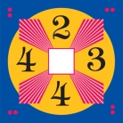
Concept
We had originally picked another project, but after major issues getting the environment to work we switched gears.
Math 24 is a popular game in some parts of the country for elementary and middle schoolers to play for fun, learning and to compete against other teams.
The actual card games uses a and using the four basic math operators +, -, /, * the player is supposed to get the numbers to equal 24.

Slide 3
Purpose
To take an enjoyable table game primarily used for educational purposes and make it accessible on a players computer.
Short term goal: single player Math24 game play
Long term goal: multiplayer Math24 game play
Target demographic: all

Slide 4
Initial Functional Requirements
GUI
Calculations
Technical details
Data manipulation
Data processing
Algorithms implementation
Notes:
The GUI should be able to receive input from the user; such as, select numbers, select an operation, and view solution
Allow user to perform operations on four numbers so that the ending result is 24.
All four numbers must be used and each number can only be used one time.
Each successful combination that yields a result of 24 counts as one point towards the score for the game.
The user will win the game when they reach a total score of 10.
The operations allowed in the game are the following:
Addition
Subtraction
Multiplication
Division
The application will always display the current computation at the time; for instance, if the game player select the number 5, then clicks on the addition button, and then clicks on the number 4 the application will display the total computation of 9.

Slide 5
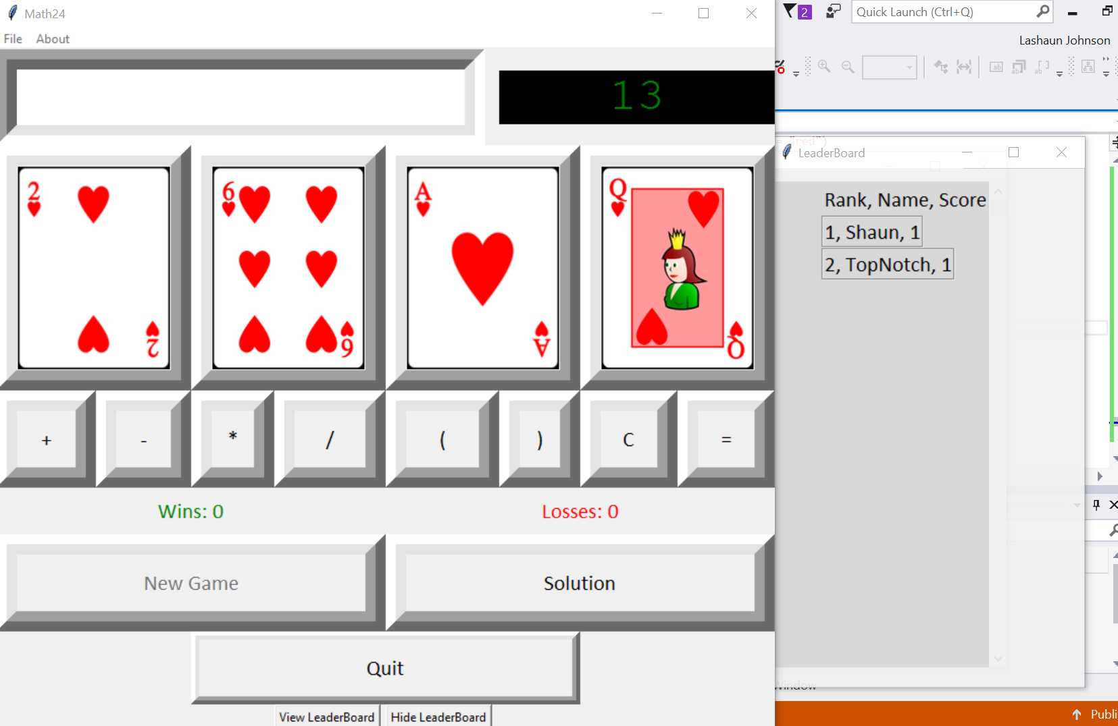
Initial Functional Requirements cont.
GUI on Windows
Notes:
The application should include a leaderboard system that captures and displays the rank, name, score, and time of the top ten high-scoring leaders.
If a new high score is achieved, the user should be notified and prompted to enter a name.
A database or text file should be used to store leaderboard information.
The program should initialize, reference, append, sort and parse items in the leaderboard database.

Slide 6
Initial Non Functional Requirements
Play the game on any computer
Make the numbered buttons look like cards
Make the game look nice
Open source
Maintainability
Portability
Usability
Extensibility

Slide 7
Requirement Modifications
Actual modification
You win the game at 10. However you can continue playing.
Additions rather than modifications:
Timer
Cards design for buttons
Leaderboard

Slide 8
Technical Barriers
Graphical User Interface Testing
Integration
Refactoring
Windows vs Mac GUI Design
4 out of 6 team members had very little to no experience with Python programming language

Slide 9
System Configuration
Windows or Mac
Python 3.5 or greater
All platforms

Slide 10
Test Framework and Results
Whitebox Unit Testing
Using unittest
Blackbox Testing
General Game Testing to verify game play functionality
Manual GUI Testing
Goal was to verify overall application functionality worked. Example: Solution button.
Testing documentation used for the following:
Bugs found
Bugs fixed and developer that made the fix

Slide 11
Coding Style
PEP8 is the Coding Style
We do follow some of the:
Python Naming Convention requirements:
Instance methods have their first argument named ‘self’
Using lower cases and underscores to improve readability

Slide 12
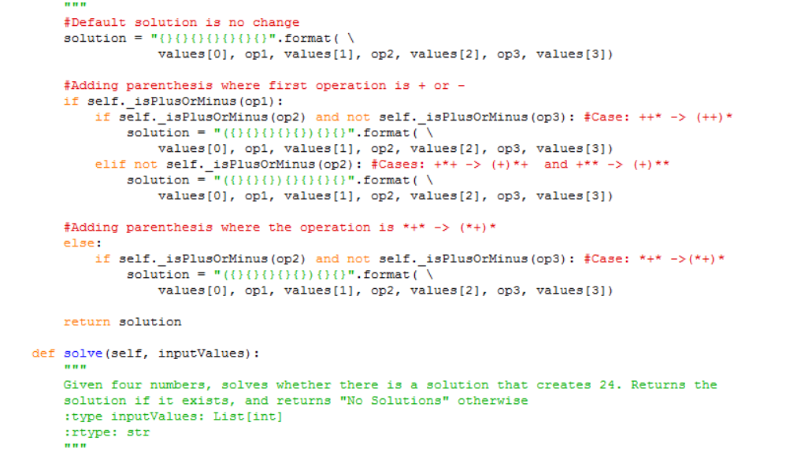
Coding Style Continued
Commenting is used primarily to point out what a part of the code does.

Slide 13
Possible future components
Multiplayer: two or more people playing at the same time from different consoles.
Available on mobile devices

